Slide 1
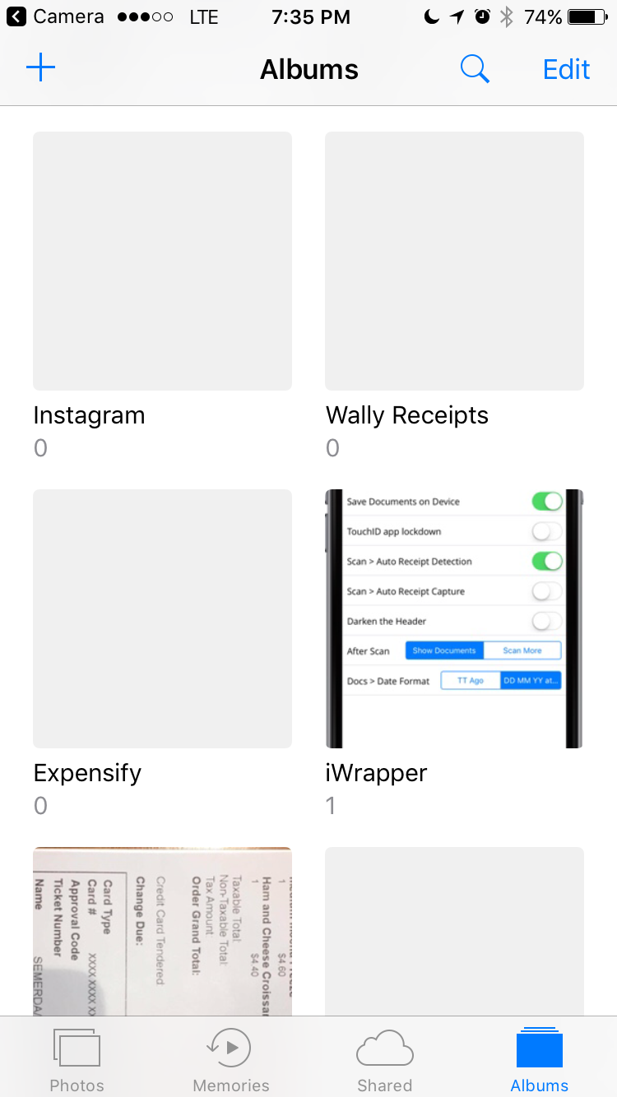
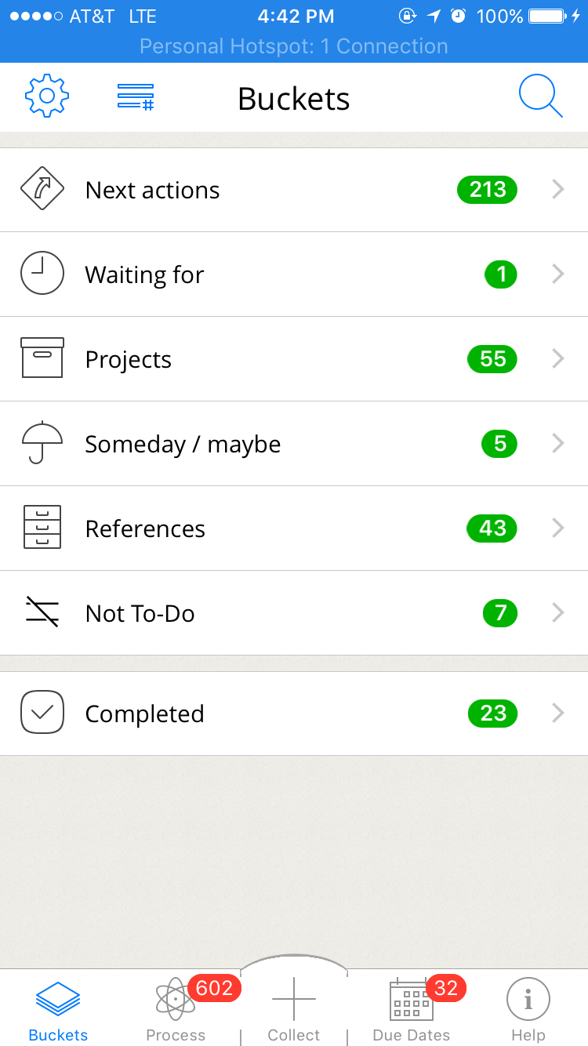

1st Start
Restarts
Permissions granted
Swipe up to Trash it (with animations)
Select Photo
A
Swipe Left
Permissions not granted
Swipe Left
Swipe Right

Slide 2
Toolbox can be dragged to any corner
Swipe right to hide with tab ending left exposed to pull it out again
A
Color palette
Tools
Arrow using freeform
Text
Blur
Undo
Audio
🎧
Swipe left to go to Gallery
Swipe right to Export into Jira et al

